Slide 1
Western NY Children’s Psychiatric Center Longitudinal APPE: Hospital Health Systems Pharmacy Elective - Direct Patient Care/Non-Direct Patient Care
Kimberly burns, pharmd, bcps, bcpp
Director of pharmacy/site coordinator
Kimberly.burns@omh.ny.gov

Slide 2
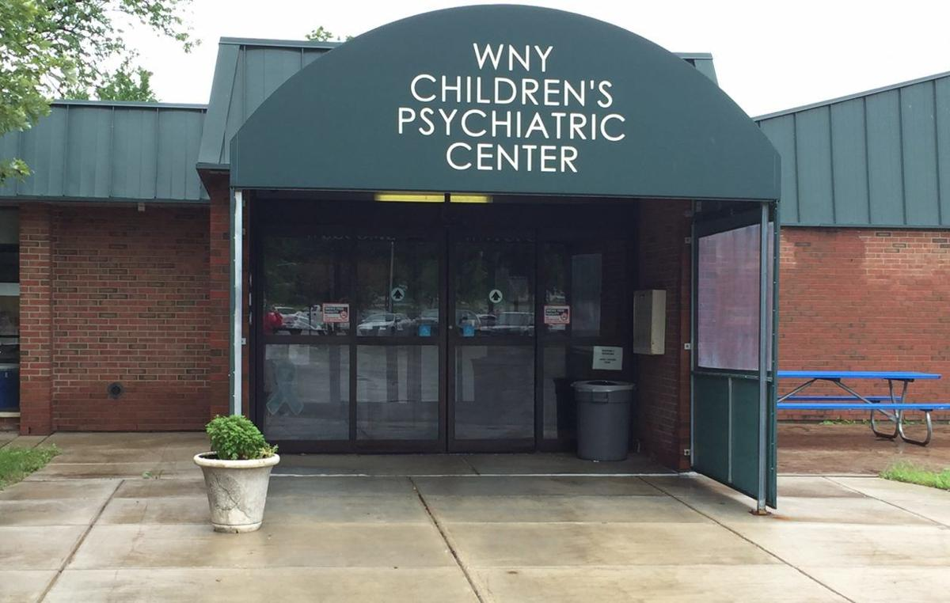
Our Facility
New York State Office of Mental Health facility
“To enhance the well being of children and their families throughout Western New York by increasing their hope, competence, and fulfilment.”
West Seneca
Inpatient: 46 beds, patients ages 4-18 years
Variety of outpatient clinics

Slide 3
Typical Day & Week
Attend morning meeting on assigned unit
Assist in medication distribution to the units
Inventory activities
Quality management of crash carts
Topic discussions, journal clubs, presentations
Attendance at facility committees

Slide 4
Interprofessional Engagement
Psychiatrists
Pediatricians
Psychologists
Social Workers
Recreational Therapists
Mental Health Therapy Aides
Nurses
Nurse Practitioners

Slide 5
Applicant
Strong communicator
Independent worker
Multitasker
Interested in psychiatry

Slide 6
What’s in it for you…
Interprofessional activities!
Interaction with families, caregivers, and patients – great counseling opportunities and growth!
So much psychiatry!

Slide 7
Western NY Children’s Psychiatric Center Longitudinal APPE:. Hospital Health Systems Pharmacy Elective - Direct Patient Care/Non-Direct Patient Care
Kimberly burns, pharmd, bcps, bcpp
Director of pharmacy/site coordinator
Kimberly.burns@omh.ny.gov

